Slide 1
Introduction to One-Equation and Two-Equations Models
Presented By: Ahmed Saber
Presented To: Dr.Rola Afify

Slide 2
Introduction
As computers have increased in power since the 1960's, turbulence models based upon the equation for the turbulence kinetic energy have become the cornerstone of modern turbulence-modeling research, like One-Equation Models and Two-Equation Models.
One-equation models based on the turbulence kinetic energy equation are incomplete as they relate the turbulence length scale to some typical flow dimension.
Two-equation models and one-equation models based on an equation for the eddy viscosity automatically provide the turbulence length scale or its equivalent and are thus complete.
This presentation shows derivation for the turbulence kinetic energy equation.

Slide 3
The Turbulence Kinetic Energy Equation

Slide 4
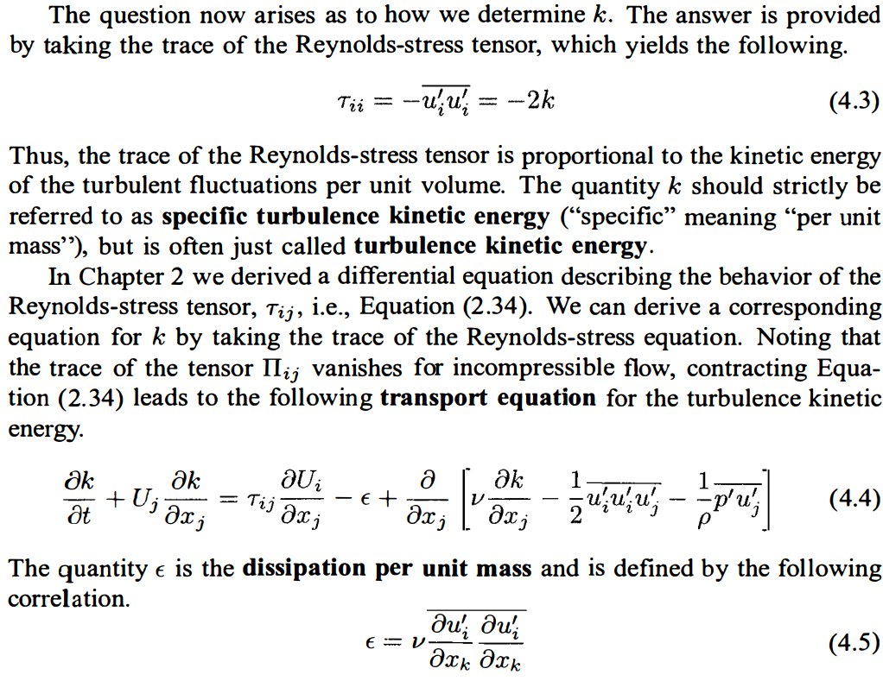
The Turbulence Kinetic Energy Equation

Slide 5
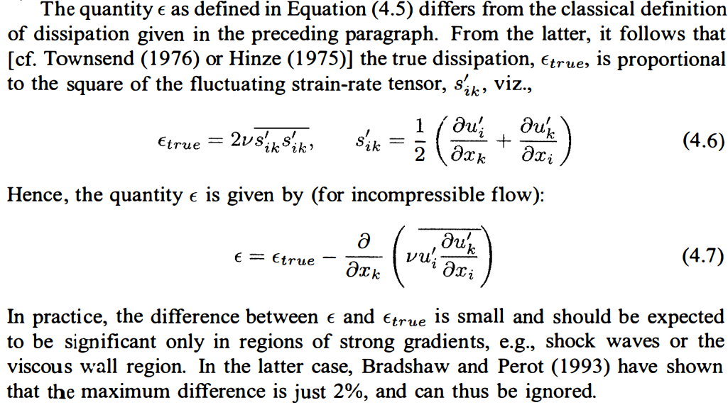
The Turbulence Kinetic Energy Equation

Slide 6
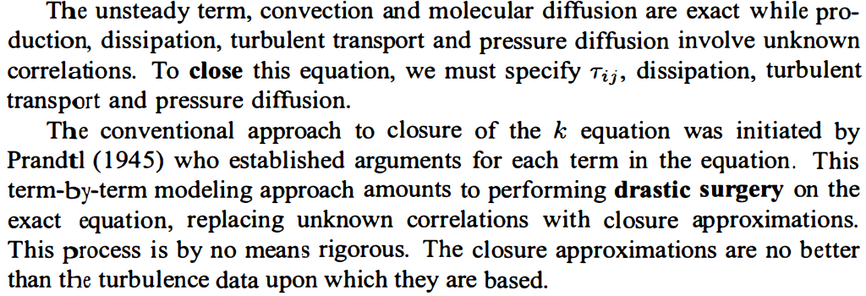
The Turbulence Kinetic Energy Equation

Slide 7
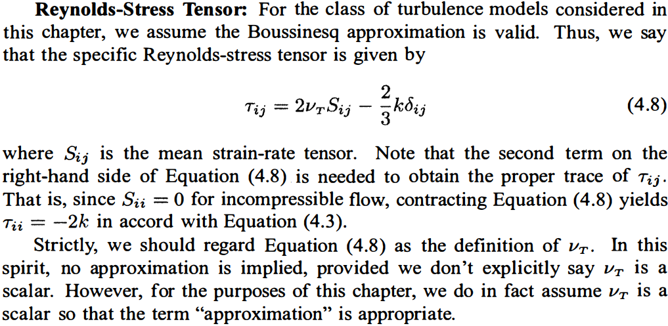
The Turbulence Kinetic Energy Equation

Slide 8
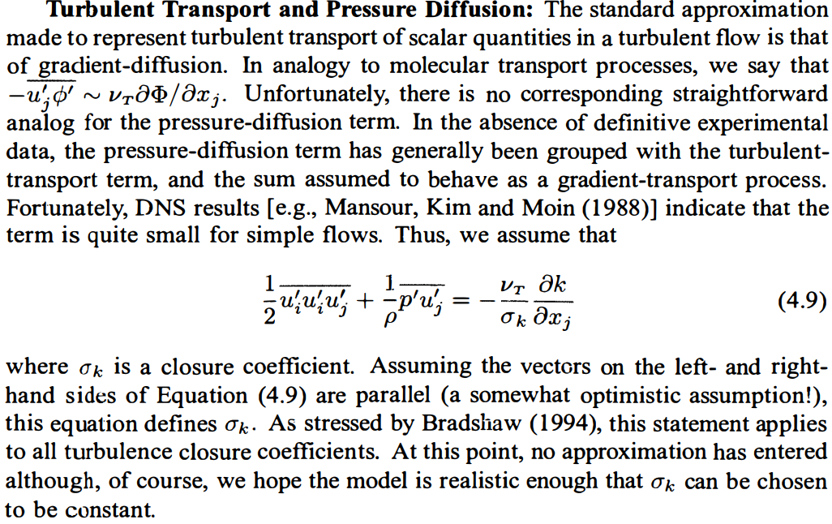
The Turbulence Kinetic Energy Equation

Slide 9
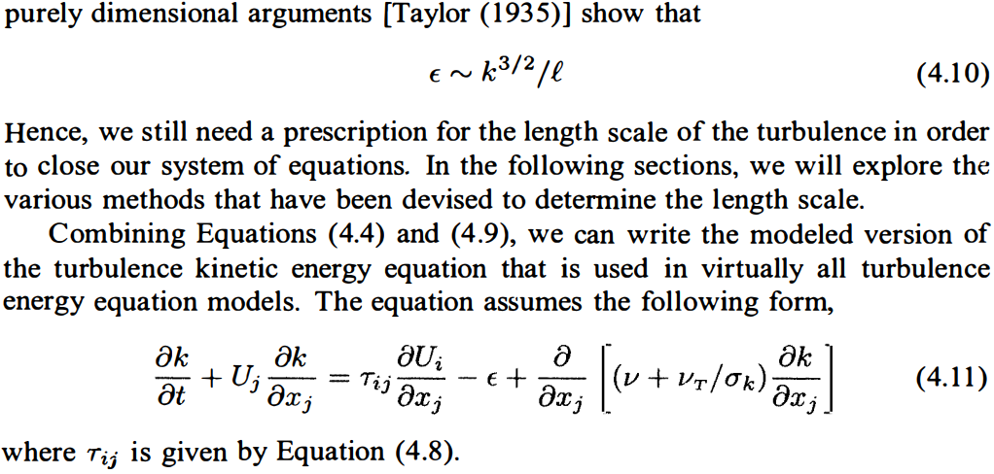
The Turbulence Kinetic Energy Equation

Slide 10
References
Wilcox, D.C. (2006) Turbulence Modeling for CFD. 3rd Edition, DCW Industries, Canada, CA, USA.

