Slide 1
Basic Electrical Controls for Fluid Power Circuits
Presented By: Ahmed Saber
Presented To: Dr. Kamal Abd Elaziz
Dr. Rola Afify

Slide 2
Objectives
Understand the function of the various electrical components.
Read and understand the operation of electrical circuit diagrams.
Interrelate the operation of electrical circuit diagrams with the fluid power circuits.

Slide 3
Content
Introduction.
Circuit Diagram.
Basic Electrical Devices.
Examples.
Reference.

Slide 4
Introduction
In recent years, the trend has been toward electrical control of fluid power systems and away from manual control because of the following reasons:
Electrical devices improve the control flexibility of fluid power systems.
More machines are being designed to be controlled with electrical signals from computers.

Slide 5
Circuit Diagram
When drawing electrohydraulic or electropneumatic circuits, a separate circuit is drawn for the fluid system and a separate circuit is drawn for the electrical system.
Each component is labeled to show exactly how the two systems interface.
Electrical circuits use ladder diagrams with the power connected to the left leg and the ground connected to the right leg.

Slide 6
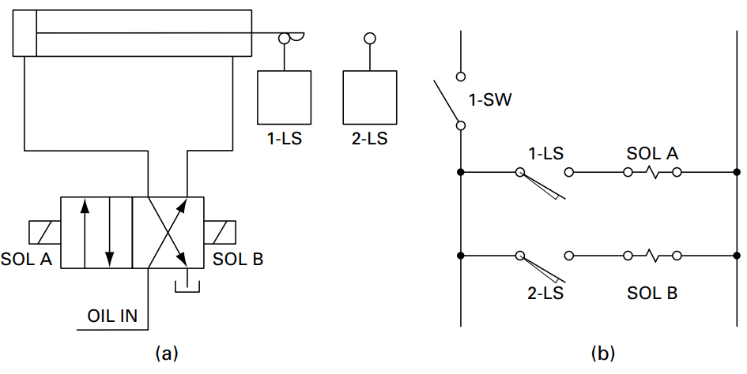
Circuit Diagram
Reciprocation of cylinder using limit switches.

Slide 7
Basic Electrical Devices
There are seven basic electrical devices commonly used in the control of fluid power systems:
Push-button switch.
Limit switch.
Pressure switch.
Temperature switch.
Timer.
Solenoid.
Relay.

Slide 8
Basic Electrical Devices
Switches can be wired either normally open (NO) or normally closed (NC).
Normally open (NO) : no electric current can flow through the switching element until the switch is actuated.
Normally closed (NC) : electric current can flow through the switching element until the switch is actuated.

Slide 9
1. Push-button switch.
Function: Starting and stopping the operation of machinery as well as providing manual override when an emergency arises.
Symbol:

Slide 10
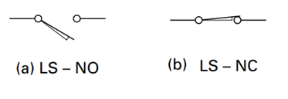
2. Limit switch.
Function: Open and close the circuit when it is actuated either at the end of the retraction or extension strokes of cylinders by using cam, lever, or roller.
Symbol:

Slide 11
3. Pressure switch.
Function: Open or close the circuit based on predetermined system pressure. It may be used to start or stop a pump to maintain a given pressure.
Symbol:

Slide 12
4. Temperature switch.
Function: Open or close the circuit based on a predetermined temperature. It can be used to protect the fluid power system from serious damage.
Symbol:

Slide 13
5. Timer.
Function: Timers are used in electrical control circuits when a time delay from the instant of actuation to the closing of contacts is required.
Symbol:

Slide 14
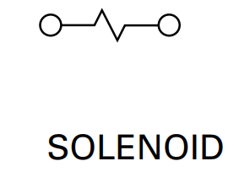
6. Solenoid.
Function: Provide a push or pull force to operate fluid power valves remotely.
Symbol:

Slide 15
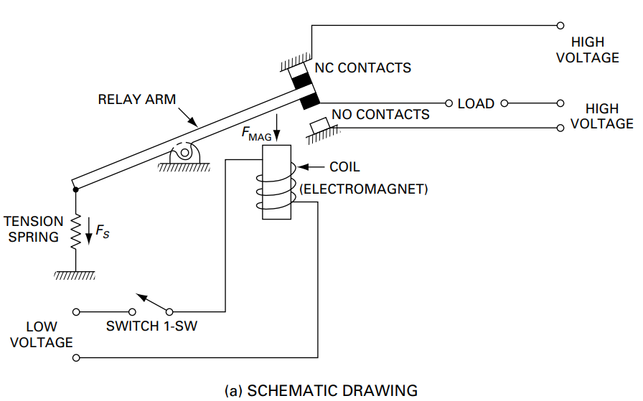
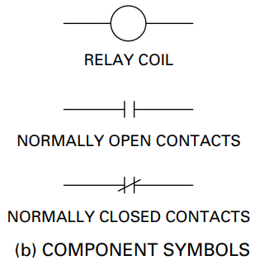
7. Relay.
Function: Used for activation and de-activation of solenoids because they operate at a high voltage level.
Symbol:

Slide 16
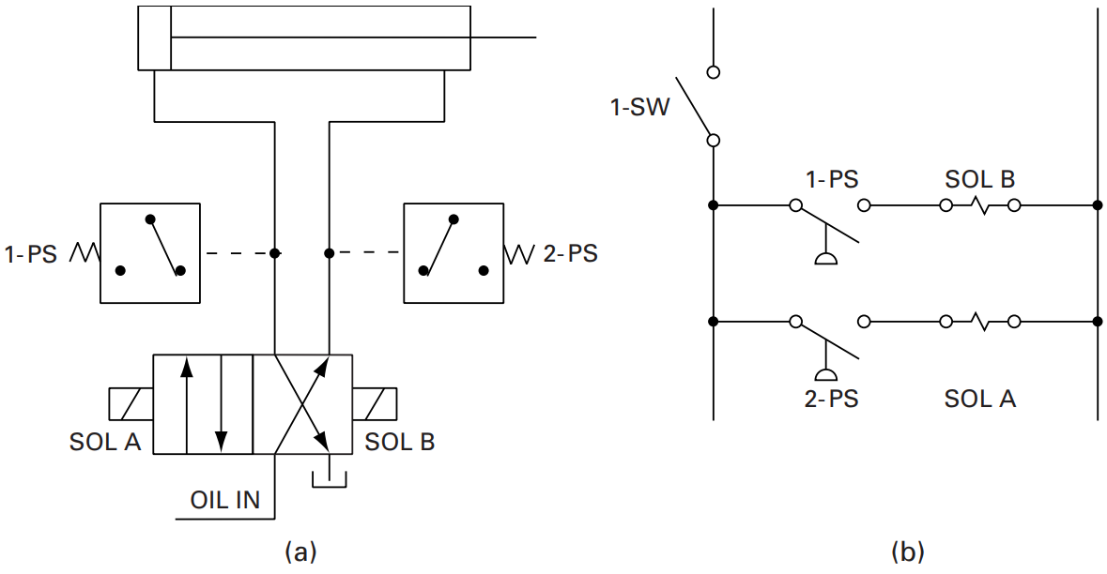
Examples
double acting cylinder
pressure switch
solenoid-actuated, four-way, two position, directional control valve
a) Reciprocation of cylinder using pressure switches.

Slide 17
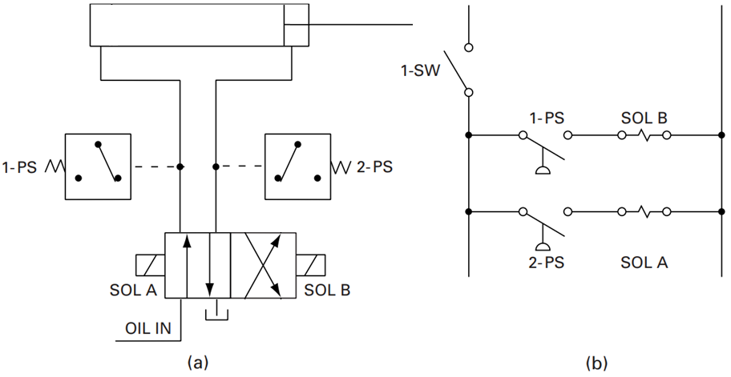
Examples
a) Reciprocation of cylinder using pressure switches.

Slide 18
Examples
a) Reciprocation of cylinder using pressure switches.

Slide 19
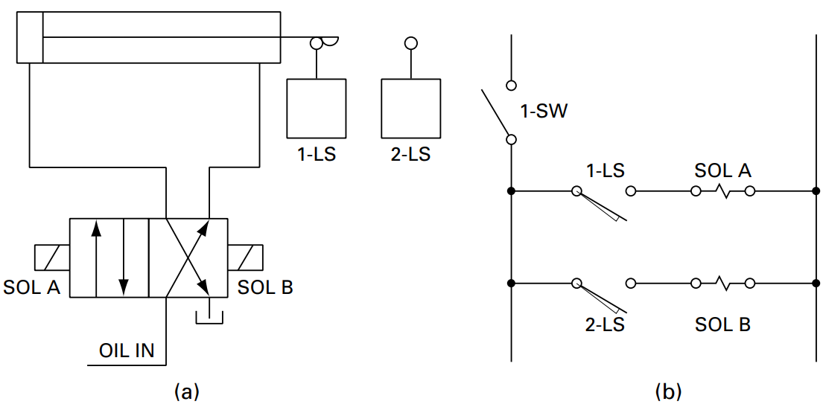
Examples
double acting cylinder
limit switch
solenoid-actuated, four-way, two position, directional control valve
b) Reciprocation of cylinder using limit switches.

Slide 20
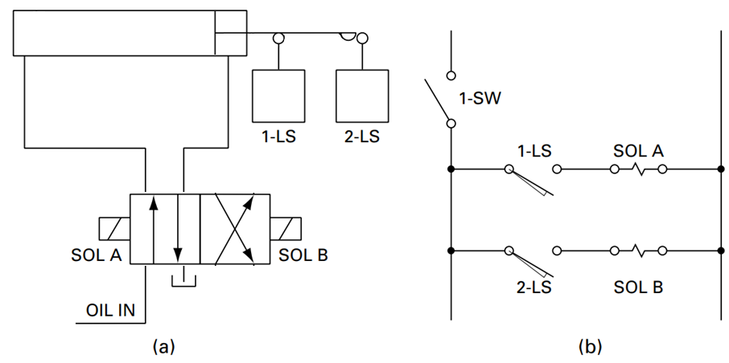
Examples
b) Reciprocation of cylinder using limit switches.

Slide 21
Examples
b) Reciprocation of cylinder using limit switches.

Slide 22
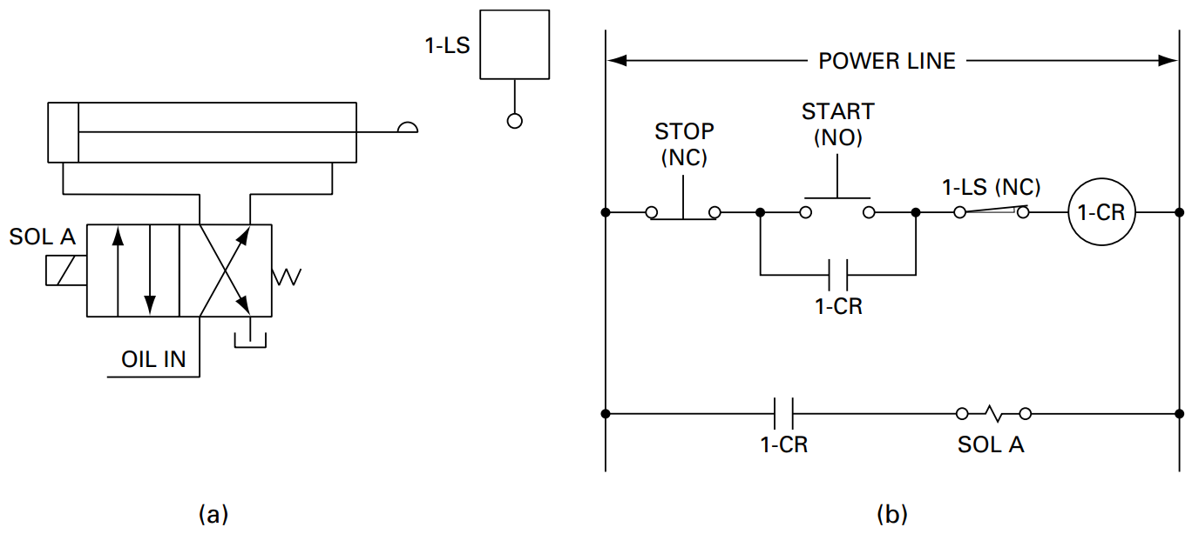
Examples
double acting cylinder
limit switch
single solenoid-actuated, four-way, two position, spring-offset, directional control valve
c) Control of hydraulic cylinder using single limit switch.

Slide 23
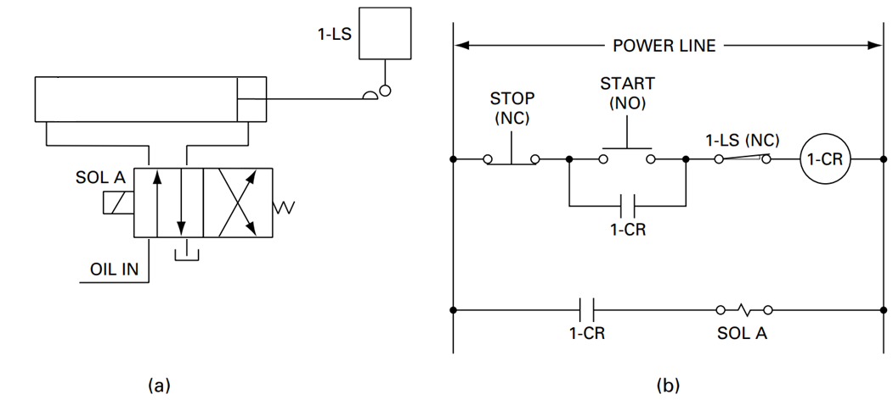
Examples
c) Control of hydraulic cylinder using single limit switch.

Slide 24
Examples
c) Control of hydraulic cylinder using single limit switch.

Slide 25
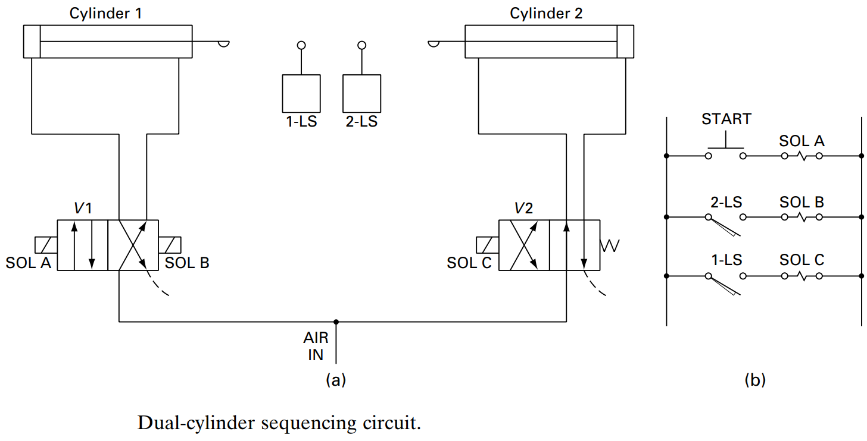
Examples
double acting cylinder
limit switch
solenoid-actuated, four-way, two position, directional control valve
single solenoid-actuated, four-way, two position, spring-offset, directional control valve
d) Dual-cylinder sequencing circuit.

Slide 26
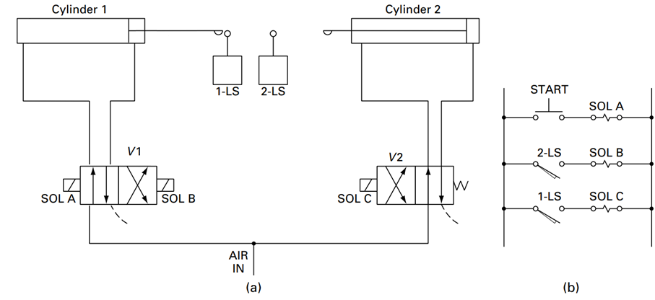
Examples
d) Dual-cylinder sequencing circuit.

Slide 27
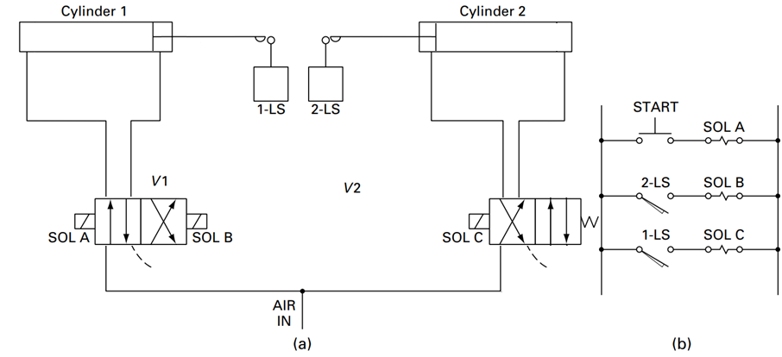
Examples
d) Dual-cylinder sequencing circuit.

Slide 28
Examples
d) Dual-cylinder sequencing circuit.

Slide 29
Reference
Fluid Power with Applications 7th Edition by Anthony Esposito

Slide 30
THANK YOU

