Slide 1
Hydraulic Filters
The Best Designed Components and the Most Carefully thought out Circuits Require Clean Fluid to achieve Optimum Performance.
All Hydraulic Fluids contain Dirt to some degree.
But, the need of a Filter, Fig 1, in a System is many times Not Recognized.
After all, the addition of Filter does Not increase a Machine's apparent Actions. in Hydraulic Fluid is the Downfall of Even the Best Designed Hydraulic Systems
Great Majority of Component and System Malfunctions is caused by Particles of Dirt
Dirt Particles can bring Huge and Expensive Machinery to its knees

Slide 2
Fig 1 Filter Symbol

Slide 3
Dirt Interferes with Hydraulic Fluid
Dirt causes Trouble in a Hydraulic System because It Interferes with
The Fluid which has Four Functions:
To act as a Medium for Energy Transmission
To Lubricate Internal Moving Parts of Hydraulic Components
To act as a Heat Transfer Medium
To Seal Clearances between close fitting Moving Parts
Dirt interferes with Three of these Functions.
Dirt interferes with the Transmission of Energy by
Plugging Small Orifices in Hydraulic Components like
Pressure Valves and Flow Control Valves, Fig.2
In this condition Pressure has a Difficult Time Passing to
the other side of the spool.
The Valve's Action is not only Unpredictable and Non-Productive, but Unsafe.

Slide 4
Fig. 2 Plugging Small Orifices in Pressure Relief Valve

Slide 5
Because of Viscosity, Friction, and Changing Direction,
Hydraulic Fluid generates Heat during System Operation.
When the Liquid Returns to the Reservoir,
It gives the Heat up to the Reservoir Walls.
Dirt Particles interfere with Liquid Cooling by Forming a Sludge which
makes Heat Transfer to Reservoir Walls Difficult.
Clean Hydraulic Systems run Cooler than Dirty Systems, Fig.3.
The Greatest Problem with Dirt in a Hydraulic System is that
It Interferes with Lubrication.
Dirt can be Divided into Three Sizes with respect to
A Particular Component's Clearances; that is,
Dirt which is Smaller than a Clearance,
Dirt which is the Same Size, and
Dirt which is Larger than a Clearance

Slide 6
Fig. 3 Clean Hydraulic Systems run Cooler than Dirty Systems

Slide 7
Extremely Fine Dirt, which is Smaller than a Component's Clearances,
Can Collect in Clearances especially if there are Excessive Amounts
and the Valve is Not Operated Frequently.
This Blocks or Obstructs Lubricative Flow through the Passage.
An Accumulation of Extremely Fine Dirt Particles in a Hydraulic System is known as Silting, Fig.4.
Dirt which is about the Same Size as a Clearance
Rubs against Moving Parts Breaking Down a Fluid's Lubricative Film
Large Dirt can also interfere with lubrication by Collecting at
The Entrance to a Clearance and Blocking Fluid Flow between Moving Parts
A Lack of Lubrication causes: Excessive Wear,
Slow Response,
Erratic Operation,
Solenoid Burn out, and
Early Component Failure

Slide 8
Fig. 4 Dirt can be Divided into Three Sizes with respect to a Particular Component's Clearances

Slide 9
Dirt is Pollution
Dirt in a Hydraulic System is Pollution.
It is very Similar to Bottles, Cans, Paper, and Old Tires
Floating in your favorite River or Stream, Fig.5
The Difference is that Hydraulic System Pollution is measured using
A Very Small Scale
The Micrometer Scale is used to measure Dirt in Hydraulic Systems.
A Single Micrometer is invisible to the Naked Eye.
An ordinary Grain of Table Salt measures 100 micrometers (µm).
The Average Diameter of Human Hair measures 70 micrometers (µm), Fig.6.

Slide 10
Fig. 5 Hydraulic System is Pollution is Similar to Pollution in River

Slide 11
Fig. 6 Average Diameter of an Ordinary Grain of Table Salt and Human Hair

Slide 12
Limit of Visibility
The Lower Limit of Visibility for a Human Eye is 40 micrometers, Fig. 7.
The Average Person can see Dirt which measures 40 micrometers and Larger.
This Means that just because a Sample of Hydraulic Fluid Looks Clean,
Doesn't Necessarily mean that it is Clean.
Much of the Harmful Dirt in a Hydraulic System is Below 40 micrometers.
Determination of Fluid Cleanliness
Since Human Vision is Not a Proper judge,
Cleanliness of Hydraulic Fluid is Determined by Examining a Sample of
A System's Fluid by Visual Inspection With A Microscope
or With the use of an Automatic Particle Counter
In Each of These Methods,
The Number of Particles in a Micrometer Size Range is
The Determining Factor for Cleanliness

Slide 13
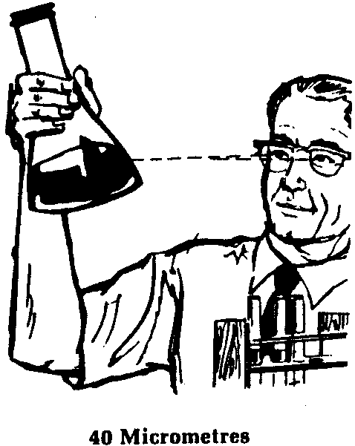
Fig. 7 The Lower Limit of Visibility for a Human Eye is 40 micrometers

Slide 14
Filter Elements
The Function of a Mechanical Filter is
to Remove Dirt from Hydraulic Fluid.
This is Done by Forcing the Fluid Stream to
Pass through a Porous Filter Element which catches the Dirt.
Filter Elements are divided into: Depth
and Surface Types.

Slide 15
Depth Type Elements
Depth Type Elements, Fig. 8, Force the Fluid to Pass through
An appreciable Thickness of Many Layers of Material
The Dirt is Trapped because of the Intertwining Path the Fluid Must Take.
Treated Paper and Synthetic Materials are
Commonly used Porous Media for Depth Elements.

Slide 16
Fig. 8 Depth Type Element

Slide 17
Nominal Rating
Since there is No One, Consistent Hole or Pore Size in a Depth Type Element,
it is given a Nominal Rating which is based on its Average Pore Size.
For Example,
A Depth Element with a Nominal Rating of 40 micrometers means that
The Element's Average Pore Size is at least 40 micrometers and that
Initially it will Remove much Dirt of 40 micrometers and smaller and
will Not Remove some Dirt which is Larger than 40 micrometers.
NOTE: Some Manufacturers Do Not use an Element's Average Pore Size
As a Basis for a Nominal Rating
In These Cases, the Nominal Rating is usually an Arbitrary Value
which Indicates Little.

Slide 18
Surface Type Elements
In a Surface Type Filter Element, Fig. 10, a Fluid Stream has
A Straight Flow Path through One Layer of Material
The Dirt is Caught on the Surface of the Element which Faces the Fluid Flow.
Wire Cloth and Perforated Metal are
Common Types of Materials used in Surface Elements.
Pore Size in Surface Type Elements
Since the Process used in Manufacturing the Cloth Material and
the Perforated Metal can be Very Accurately Controlled,
Surface Type Elements have a Consistent Pore Size.
Because of this fact, Surface Type Elements are
usually Identified by their Absolute Rating.

Slide 19
Fig. 10 Surface Type Element

Slide 20
Absolute Rating
An Absolute Rating is an indication of the Largest Opening in a Filter Element
This Rating indicates the Diameter of the Largest Hard Spherical Particle
which can Pass through an Element, Fig. 11.
Since the Pore Size can be Accurately Controlled in this type Element,
All the Holes in a 200 Wire Mesh Element are 74 micrometers Square.
A 200 Mesh Wire Element with an Absolute Rating of 74 micrometers
Means that for Every Square inch of material there are
200 Wires Running Vertically, 200 Wires Running Horizontally, and
The Perpendicular Distance between the Wires is 74 micrometers.
Therefore, the Largest, Hard Spherical Particle to Pass through the Element
would have a Diameter of 74 micrometers.
The Absolute Rating for a Depth Type Element, Fig. 12, would be
The Last Point on the Pore Size Axis of the Pore Size Distribution Curve
There may Only be One Hole of that Size in the Element,
but that would Still be its Absolute Rating.

Slide 21
Fig. 11 Absolute Rating, Square Wire Mesh

Slide 22
Fig. 12 Absolute Rating, Depth Type Element

Slide 23
Filter Ratings in Practice
As was pointed out above, an Absolute Rating indicates
The Largest Hole size in an element
Sometimes, an Absolute Rating indicates the Largest Particle which will Pass
through the Element while Operating in a System.
Since the Dirt in the common Hydraulic System is Not Spherical Particles,
This Deduction is Erroneous.
Dirt in Hydraulic Fluid is Any insoluble Material.
It comes in All Sizes, Shapes, and Materials.
An Element with an Absolute Rating of 74 micrometers may have
A Difficult time Catching a Long Thin Particle
A Sliver with an Overall Length of 150 micrometers and
A Diameter of 3 micrometers, Travels like a Rocket in a Fluid Stream.

Slide 24
The Sliver Penetrates, Fig. 13, the Element with its 3 micrometer Dimension
and Probes its way through the Relatively Large Holes.
Consequently, Using a 74 micrometer Absolute Element is No Guarantee that
All Dirt Larger than 74 micrometers will be Removed from a Fluid Stream.
An Absolute or Nominal Rating Only Indicates
A Filter Element's Largest or Average Hole Size.
Filter Ratings do Not Guarantee: What Size Particles will be Removed
or How Clean a Fluid will become.
To Determine How Fine and What Type of a Filter Element should be used
To Protect a Specific Hydraulic Component, Consult
The Component Manufacturer or a Reputable Filter Dealer

Slide 25
Fig. 13 Penetration

Slide 26
Sources of Dirt
Dirt was Previously Defined as
Any Type of Insoluble Material in a Hydraulic Fluid
Dirt comes in All Sizes,
Shapes,
Materials and
has Several Sources by which it Enters a System.

Slide 27
Dirt Built into a System
Hydraulic Systems which are Newly Fabricated are often Extremely Dirty.
As a Machine is being assembled, the Reservoir becomes a Collection Point
for Rust, Paint, Chips, Dust, Cigarette Butts, Grit and Paper Cups, Fig.14.
Even though the Reservoir is "Cleaned' before it is Filled with Fluid,
A Sample of the Fluid taken Shortly after Start up Time
will Show Dirt Particles of many Foreign Materials.
Many Dirt Particles which are Harmful to a System are Invisible to the Naked Eye and Cannot be Removed by Wiping with Rag or Blowing Off with an Air Hose
The Components which Make up a New System may also be
Sources of System Contamination, Fig. 15
Because of Storage, Handling and Installation Practices, New
Directional Valves, Cylinders, Relief Valves, and Pumps may be
Equipped with Dirt Particles which Enter a Fluid Stream after a Short Time

Slide 28
Fig. 14 Reservoir is a Collection Point for Dirt

Slide 29
Fig. 15 The Components which make up a New system May also be sources of System Contaminat

Slide 30
Dirt Generated within a System
Another Source of Dirt is the Dirt Generated within the System Itself.
As a Machine continues to Operate, Moving Parts naturally begin to
Wear and Generate Dirt.
Every Internal Moving Part in a System can be considered
A Source of Contamination for the Entire System
Component Housings are continuously Flexing from Normal Stresses
and are Constantly subjected to Hydraulic Shock Pressures.
These Actions Cause Metal and Casting Sand to
Break Loose from the Housing and Enter the Fluid Stream.
Air Entering the Reservoir during Operation contains Water Vapor, Fig. 16.
When the Machine is Shut Down, the Air inside the Tank Cools
and Water Vapor condenses on the Walls.
This Causes the Formation of Rust which eventually is Washed into the Fluid.

Slide 31
Fig. 16 Condensation Forms as System Cools Causing Rust

Slide 32
Dirt Added to a System
An Additional Source of Dirt is the Dirt added to a System.
This is many times the Result of: Ordinary Maintenance Practices
or A Lack of Maintenance.
If a Pump happens to Break Down, the Maintenance Man
Replaces the Component or Repairs it right on the spot.
In either case he will be Working in a Dirty Environment,
which will Contaminate the System as soon as a Line is Cracked, Fig. 17.
If the Pump is Disassembled,
More than likely it will be done on a Dirty workbench
and the Parts will be Wiped off with a "Not-too-Dirty" Rag before Reassembly
When the Pump is Replaced, it will Spread Dirt throughout the System, Fig. 18.

Slide 33
Fig. 17 Pump Generating Dirt

Slide 34
Fig. 18 System Repair

Slide 35
Fig. 18 System Repair

Slide 36
The Usual First Aid Measure for a Line which has Sprung a Leak is
To Put the Nearest "Clean" Bucket under the Leak, Fig. 19
After it is Repaired, the Maintenance Man must dump the Bucket of Fluid.
If No Convenient way is seen to Dispose of the Contaminated Fluid,
it is Poured Back into the Reservoir.
The Atmosphere in which the Machine lives Contaminates
A System's Hydraulic Fluid
Operation of a Hydraulic System depends upon Air Entering the Reservoir
through the Breather Cap and Pushing the Fluid Up to the Pump.
As Actuators in the System are filled and discharged with Fluid,
The Tank actually Inhales and Exhales Dirt-Laden Air which is
Filtered by a Coarse Screen in the Breather Cap.
The Dirt which is Not Filtered Out Settles into the Fluid, Fig. 20.

Slide 37
Fig. 19 Container Contaminates Fluid

Slide 38
Fig. 20 Microscopic Dirt Enter through Breather Cap

Slide 39
Breather Caps are Very Rarely, If Ever, Cleaned.
Because of this Lack of Maintenance, the Screen becomes Plugged.
As a result, the Breather Cap is removed from the Reservoir
or the Atmosphere finds a Path through an Old, Cracked Seal
or Stripped Bolt Hole.
Now a Clear Path to the Fluid is Open for Almost Anything.
Dirt can also be added to a System by means of a Cylinder.
After a Time,
A Cylinder's Rod Wiper Seal Wears, Fig. 21.
In This Condition,
Dirt is drawn into the System Each Time the Cylinder Rod Retracts.

Slide 40
Fig. 21 Dirt May Enter Through Worn Seal.

Slide 41
Type of Filtration
by
Flow
In the Early Days of Hydraulics, Filtration was Not Considered Necessary.
Clearances between Moving Parts were Large, therefore
Dirty Fluid would Not Affect Operation that much.
Components were Dirt Tolerant to a large extent.
As Manufacturing Processes naturally Improved, Tolerances were Improved.
Component Operation became Much More Efficient,
but Components were Less Dirt Tolerant.
The Need for Filtration was Recognized.

Slide 42
Proportional Flow Filtration
The first measure was to place a Filter in a System in such a way that
A Part of the Total Volume of a Pump was Filtered.
This can be done by Placing a Filter in a System so that
A Portion of a Pump's Flow is Bled off through the Filter, Fig. 22.
Full Flow Filtration
Proportional Flow Filtration was found to be Inadequate after a time, especially As System Components became More and More Efficient.
The next step was to Place a Filter in a System so that
All Flow from a Pump was Filtered, Fig. 23.
This Full Flow Filtration is the Type of Filtration used in
Most Modern Hydraulic Systems

Slide 43
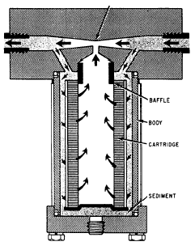
Fig. 22 Proportional-Flow Filter

Slide 44
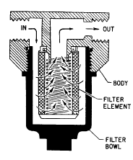
Fig. 23 Full-Flow Hydraulic Filter

Slide 45
Type of Filtration
by
Position in a System
A Filter is Protection for a Hydraulic Component.
Ideally Each System Component should be Equipped with its Own Filter,
But this is Economically Impractical in most cases.
To obtain Best Results, the Usual Practice is
to Strategically Place Filters in a System.
In the Majority of Applications
The Fluid Reservoir is a Large Source of Dirt for a System.
Since a Pump is the Heart of a System,
One of the Most Expensive Components in a System,
and One of the Fastest Moving System Components, it seems logical that a Good Place to Put a Filter is between a Reservoir and Pump.

Slide 46
Generated by the Sump Strainer
A Sump Strainer, Fig. 24 is usually a Coarse Filter Element
Screwed onto the End of a Pump's Suction Line
The Range of Filtration for Sump Strainers is a Perforated Metal Cylinder
with Large Drilled Holes to 74 micrometer Wire Mesh.
Advantages:
1. Sump Strainers Protect the Pump from Dirt in the Reservoir.
2. Because they have No Filter Housing, Sump Strainers are very Inexpensive
Disadvantages:
1- Being Below Fluid Level, Sump Strainers are Very Difficult to Service
When Cleaning is necessary, especially if the Fluid is Hot
2- A Sump Strainer does Not have an Indicator to Tell when it is Dirty.
3- A Sump Strainer may Block fluid Flow and Starve the Pump
If Not Sized Correctly and Properly Maintained
4- A Sump Strainer does Not Protect Components Downstream from the Particles Pump.

Slide 47
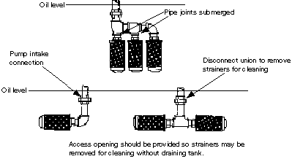
Fig. 24a Sump Strainer

Slide 48
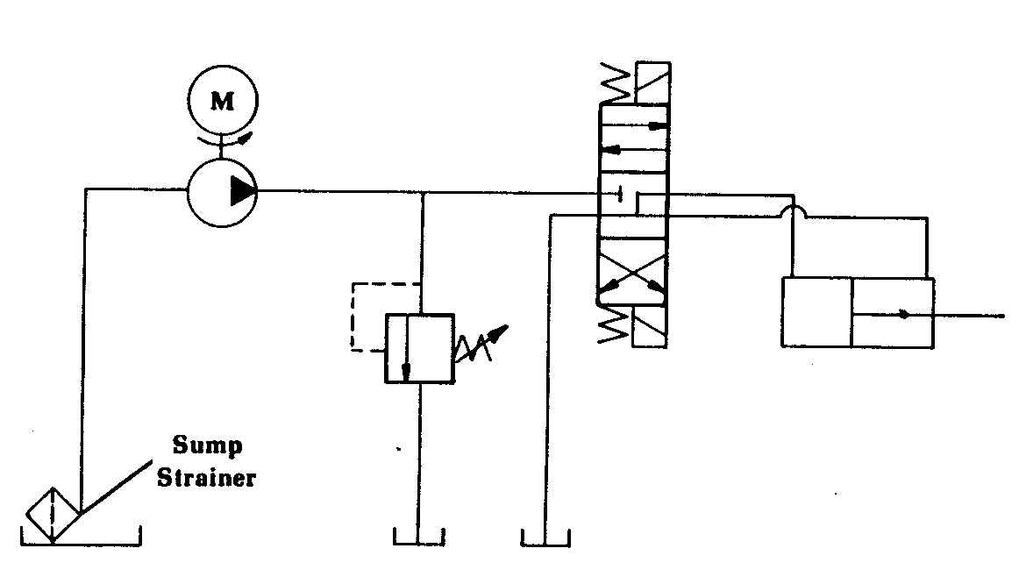
Fig. 24b Sump Strainer Circuit

Slide 49
Suction Filter
A Suction Filter, Fig.25, is placed in the Suction Line Outside of the Reservoir
Range of Filtration usually found in Suction Line Filters is 23-25 micrometers
Advantages:
1- A Suction Filter Protects the Pump from Dirt in the Reservoir.
2- Since the Suction Filter is Outside the Reservoir,
an indicator telling when the element is dirty can be Used.
3- The Filter element can be serviced without
Disassembling the Suction Line or Reservoir
Disadvantages:
1- A Suction Filter may starve the Pump
If Not Sized or Engineered into the System Properly.
2- A Suction Strainer does Not Protect Components Downstream from
the Particles Generated by the Pump.

Slide 50
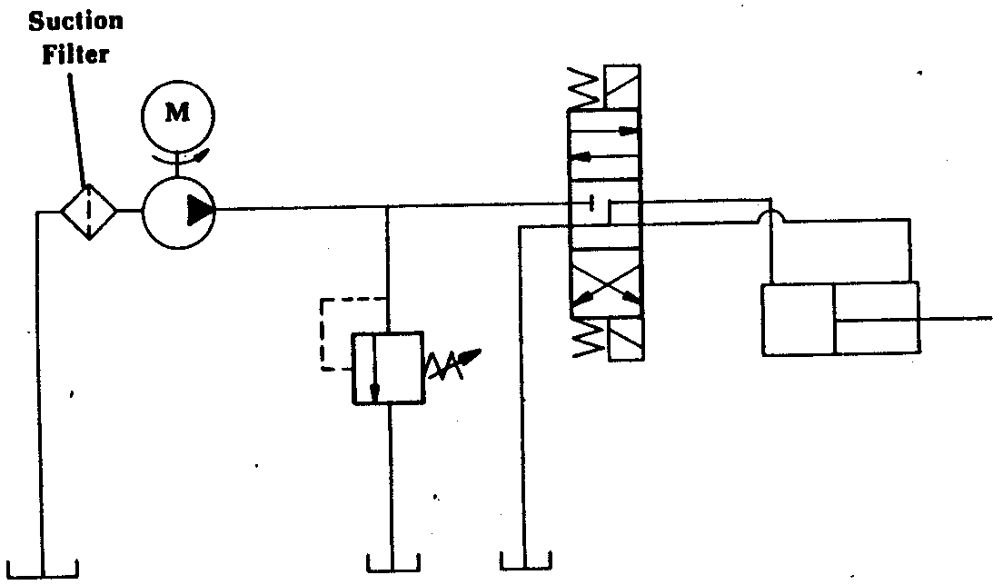
Fig. 25 Suction Filter

Slide 51
Pressure Filter
A Pressure Filter, Fig. 26, is positioned in the Circuit
between the Pump and a System Component.
Range of Filtration usually found in Pressure Line Filters is 40-3 micrometers.
A Pressure Filter can also be positioned between System Components.
If the Flow between the Components can flow in Two Directions
(as between directional valve and cylinder),
The Filter must be capable of Handling Bi-Directional Flow.
Bi-Directional Pressure Filters are used on
The Downstream Side of Servo Valves
and in Closed Looped Hydrostatic Transmissions.

Slide 52
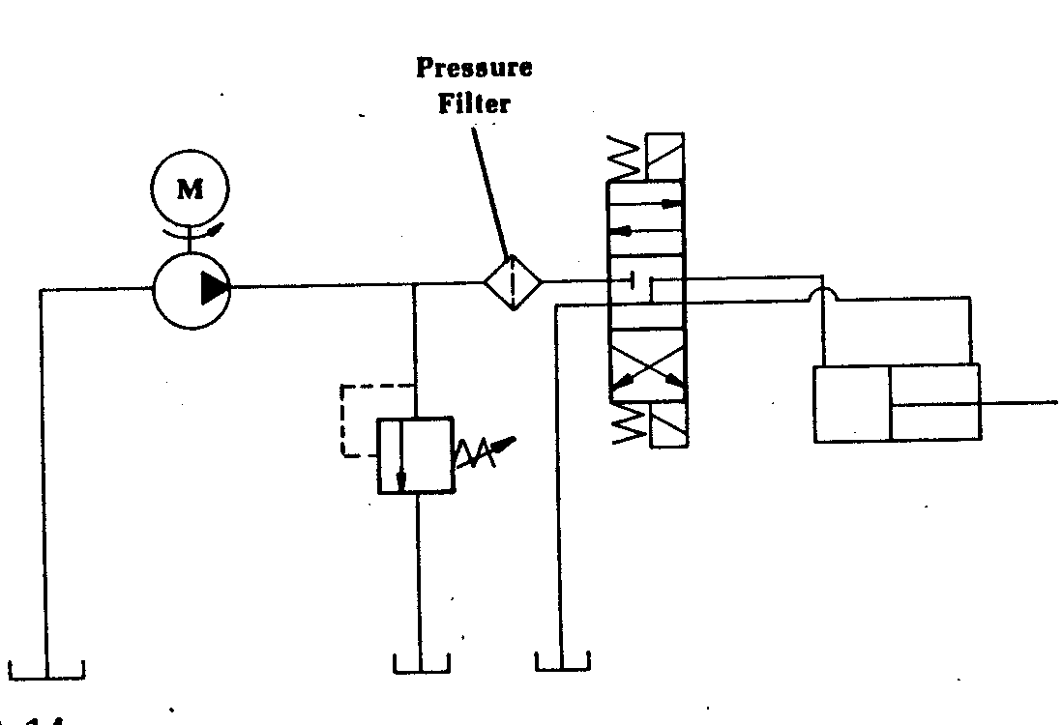
Fig. 26 Pressure Filter

Slide 53
Advantages:
1- A Pressure Filter can Filter Very Fine since System Pressure is Available
to Push the Fluid through the Element.
2- A Pressure Filter can Protect a Specific Component from the Harm
of Deteriorating Particles generated from an Upstream Component.
Disadvantages:
1. The Housing of a Pressure Filter must be Designed for High Pressure
because it is operating at Full System Pressure.
This makes the Filter Expensive.
2. If Pressure Differential and Fluid Velocity are High Enough,
Dirt can be pushed through the Element or the Element may Tear or Collapse.

Slide 54
Return line Filter
A Return Line Filter, Fig. 27, is Positioned in the Circuit of Filtration usually found in Return Line Filters is from 40-5 micrometers
Advantages:
1- A Return Line Filter catches the Dirt in the System Before it Enters the Reservoir.
2- The Filter Housing does Not Operate under Full System Pressure
and is therefore Less Expensive than a Pressure Filter.
3- Fluid can be Filtered Fine since
System Pressure is Available to Push the Fluid through the Element.
Disadvantages:
1- There is No Direct Protection for Circuit Components.
2- In Return Line Full Flow Filters, Flow Surges from Discharging
Cylinders, Actuators, and Accumulators must be considered when Sizing.
3- Some System Components may be affected by
The Back Pressure generated by a Return Line Filter.

Slide 55
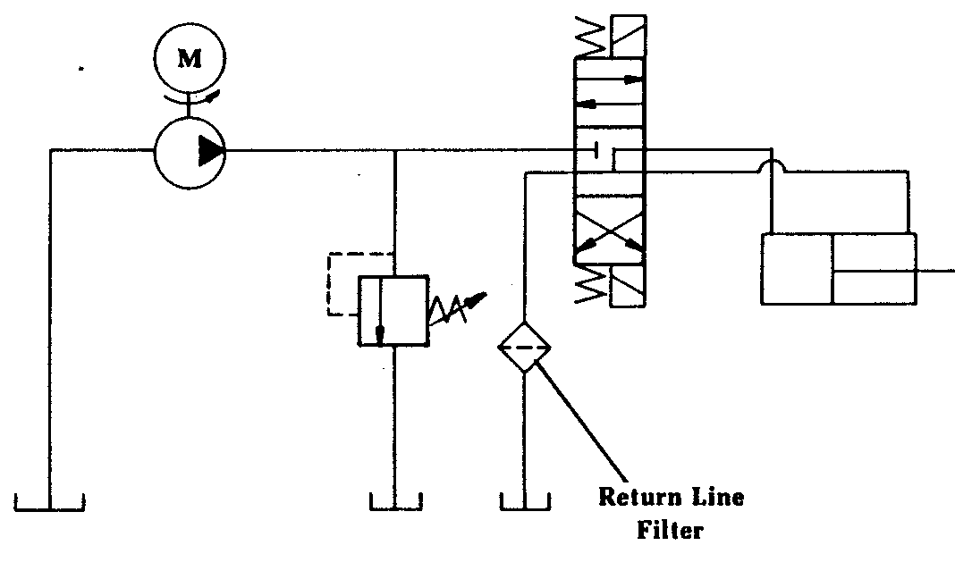
Fig. 27 Return line Filter

Slide 56
Filter Indicator
A Filter Indicator shows the Condition of a Filter Element, Fig. 31.
It indicates when the Element is: Clean,
or in the Bypassing Condition.
One Common Type of Filter Indicator consists of a Helix
and a Dial Indicator which is attached to the Helix.
The Operation of a Filter Indicator is Dependent on
The Movement of the Bypass Piston, Fig. 32
When the Element is Clean,
The Bypass Piston is Fully Seated and the Indicator shows "Clean".
While Pressure Differential across the Piston and Element Increases
To the point where the Filter Needs Cleaning, the Piston Moves up.
During its Movement, the Piston twists the Helix which
Positions the Indicator dial at "Needs Cleaning."

Slide 57
Fig. 31 Filter Indicator

Slide 58
Fig. 32 Operation of Filter Indicator

Slide 59
If the Filter Element is Not Cleaned when indicated,
Pressure Differential will Continue to Increase.
The Piston will Continue to Move up and Bypass the Fluid.
At this time the Indicator will show a Bypassing Condition.
Full-Flow Hydraulic Filter Without Contamination Indicator
are shown in Fig. 33.
A Machine may be Equipped with the Best Filters available and
They may be Positioned in the System where they do the Most Good;
But,
If the Filters are Not Taken Care of and Cleaned when Dirty,
The Money Spent for the Filters and their installation has been wasted.
A Filter which gets Dirty after One Day of Service and is Cleaned 29 Days Later Gives 29 Days of Non-Filtered Fluid

Slide 60
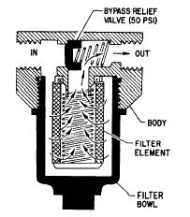
Fig. 33Full-Flow Hydraulic Filter
(Without Contamination Indicator)

Slide 61
Filtering Material and Elements
The General Classes of Filter Materials are: Mechanical,
Absorbent Inactive,
Absorbent Active
Mechanical Filters contain Closely Woven Metal Screens or Discs.
They generally Remove only Fairly Coarse Particles.
Absorbent Inactive Filters, such as
Cotton, Wood Pulp, Yarn, Cloth, Resin, Remove much Smaller Particles
Some Remove Water and Water-Soluble Contaminants
The Elements often are Treated to make them Sticky
To Attract the Contaminants found in Hydraulic Oil.
Absorbent Active Materials, such as Charcoal and Fuller's Earth
(a claylike material of very fine particles used in the purification of mineral or vegetable-base oils), are Not Recommended for Hydraulic Systems.

Slide 62
The Three Basic Types of Filter Elements are: Surface,
Edge,
Depth
A Surface-Type Element is made of Closely Woven Fabric
or Treated Paper
Oil flows through the Pores of the Filter Material,
and the Contaminants are Stopped.
An Edge-Type Filter is made up of Paper
or Metal Discs.
Oil Flows through the Spaces between the Discs.
The Fineness of the Filtration is determined by the Closeness of the Discs.
A Depth-Type Element is made up of Thick Layers of Cotton,
Felt, or
Other Fibers
which provide many Tortuous Paths for the fluid to flow through.
The Pores or Passages must be Larger than the Rated Size of the Filter

Slide 63
Particles are to be Retained in the Depth of the Media
rather than on the Surface.
There is a Statistical Probability that a rather Large Particle
may pass through a Depth-Type Filter.
Filter Elements may be of the: 5-micron,
Woven Mesh,
Micronic,
Porous Metal,
Magnetic Type
The Micronic and 5-micron Elements have Noncleanable Filter Media
and are disposed of when they are removed.
Porous Metal,
Woven Mesh, and
Magnetic Filter Elements are usually Designed to be Cleaned and Reused.

Slide 64
Micron Noncleanable Filter Elements
The Most Common 5-micron Filter Medium is composed of
Organic and Inorganic Fibers Integrally Bonded by
Epoxy Resin and Faced with a Metallic Mesh Upstream and Downstream
for Protection and Added Mechanical Strength.
Filters of this Type are Not to be Cleaned under any circumstances
and will be Marked Disposable or Noncleanable.
Another 5-micron Filter Medium Uses Layers of
Very Fine Stainless-Steel Fibers
Drawn into a Random but Controlled Matrix
Filter Elements of this Material may be Either Cleanable or Noncleanable,
Depending upon their Construction.

Slide 65
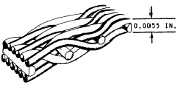
Woven Wire-Mesh Filter Elements
Filters of this Type are made of Stainless Steel
and are generally Rated as 15 or 25 micron (absolute).
Figure 35 shows a magnified Cross Section of
A Woven Wire-Mesh Filter Element
This Type of Filter is Reusable
Fig. 35 Cross-section of a Stainless Steel Hydraulic Filter Element

Slide 66
Micronic Hydraulic Filter Element
The term Micronic is derived from the word Micron.
This term has become associated with a Specific Filter with
A Filtering Element made of a Specially Treated Cellulose Paper (Fig. 7).
The Filter shown in Figure 36 is a Typical Micronic Hydraulic Filter.
This Filter is Designed to Remove 99 % of
All Particles 10 to 20 microns in Diameter or Larger
The Replaceable Element is made of Specially Treated
Convolutions (Wrinkles) to increase its Dirt-Holding Capacity
The Element is Noncleanable and should be
Replaced with a New Filter Element during Maintenance Inspections

Slide 67
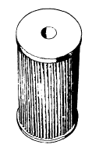
Fig. 36 Micronic Filter Element

Slide 68
Magnetic Filters
Some Hydraulic Systems have Magnetic Filters
Installed at Strategic Points
Filters of This Type are Designed primarily to
Trap any Ferrous Particles that may be in the system.

Slide 69
Characteristics to Consider When Specifying a Filtration System
1) Oil Viscosity
2) Flow
3) Pressure
4) What Components will be protected by the filter
5) Cleanliness level required (expressed in
ISO code)
6) Type of oil/fluid
7) Environment (the system, the surrounding
conditions, etc.)
8) Duty cycle
9) Operating Temperature

Slide 70
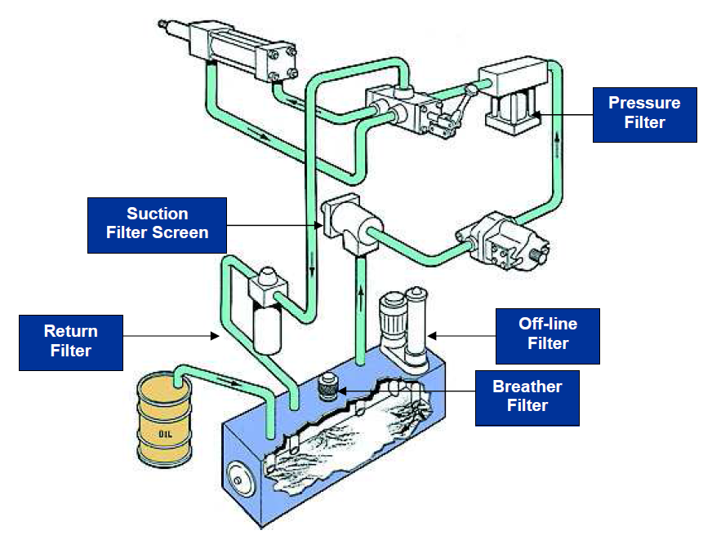
Filter Types and Locations

Slide 75
Filter problems
pressure drop
reduced flow through filter - dirty oil is passing through it
to big flow (punctured filter)- dirty oil is passing through it
bad maintenance
poor quality
bad oil or fuel quality

Slide 76
Filter Maintenance
locally inspecting the inlet and outlet manometers
following instruction book
buying original spare parts
regular cleaning intervals
be aware of oil quality
filters indicator is not a preferred method of monitoring because if the indicator is showing by-pass then damage has already been done
NEW OIL + DIRTY FILTER = DIRTY OIL

