Slide 1
Fluid Logic Control Systems
Prepared By: AbdAllah Aboualy
SUPERVISED By : Prof. KAMAL ABD-ELAZIZ
A. Prof. ROLA AFIFY

Slide 2
Content
Introduction
Advantages of pneumatic control components
Basic logic control component (OR / AND valves)
Cause and effect concept
Complex logic control circuits

Slide 3
introduction
Because of the advantages of non-pollution, low-cost, high reliability, and long life of pneumatic system, it is widely used in machinery, automatic control and other fields. At present, the common control methods of pneumatic control system are PLC control, single chip microcomputer control, electrical control and full pneumatic control.
Automated machines often mix pneumatic actuation (cylinders, air motors, blowers, suction cups, etc.) and electrical actuation (motors, heat resistors, electro-magnets, etc.).
In choosing control hardware, the designer should seek to maximize overall system uniformity.
Therefore:
Pneumatic controls should be used when the majority of actuators are pneumatic.
Electrical controls should be used when the majority of actuators are electrical.

Slide 4
Advantages of pneumatic control components
Total Pneumatic control systems have a number of advantages over electropneumatic actuation. Among these are:
System Uniformity
Hardware Uniformity
Use in Wet Environments:
Use in Explosive Environments:
Elimination of Solenoid Valves
Elimination of Electric signal
Increased Safety
Longer Life and Increased Reliability
Faster Response Times
Reduced Overall Costs

Slide 5
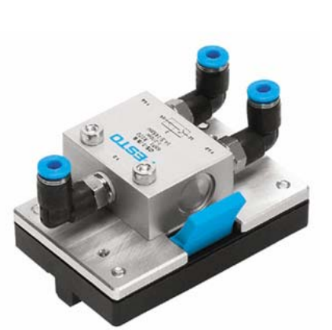
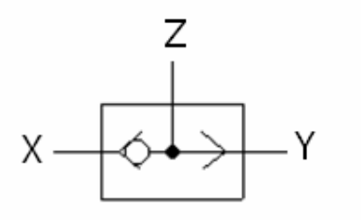
Application of single logic component
Certain pneumatic systems, the supply of compressed air to a subsystem must be from more than one source to meet system requirements. In some systems an emergency system is provided as a source of pressure in the event of normal system failure. The main purpose of the shuttle valve is to accept the pneumatic signals from two different locations. It is small and simple; yet, it is a very important component
A shuttle valve is a type of valve which allows fluid to flow through it from one of two sources. Generally a shuttle valve is used in pneumatic systems, although sometimes it might be found in hydraulic systems.
Figure (1) shows the picture of the shuttle valve.
Figure (2) shows the ISO symbol of the shuttle valve.
Figure 1
Figure 2

Slide 6
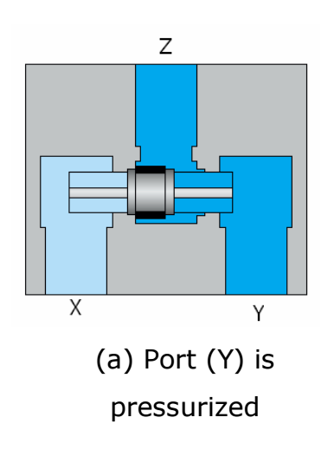
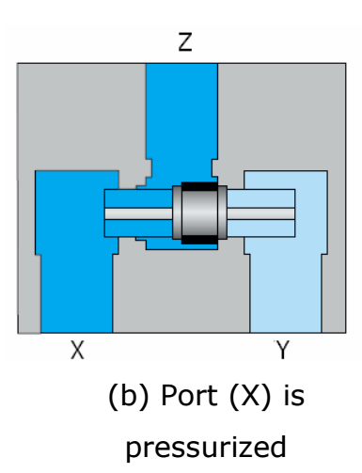
Application of single logic component
The basic structure of a shuttle valve is like a tube with three openings; one on each end, and one in the middle. A ball or other blocking valve element moves freely within the tube.
When the pressure is exerted through an opening on one end (port Y in figure 3.a) it pushes the ball towards the opposite end (port X). This prevents the fluid from travelling through that opening, but allows it to flow through the middle opening (port Z).
In this way, two different sources can provide pressure without any backflow from one source to the other as shown in figure (3.a)
and figure (3.b)
Figure 3.a
Figure 3.b

Slide 7
Application of single logic component
In pneumatic logic, a shuttle-valve works as an OR gate
If a compressed air signal is applied to input X or input Y, this will produce a signal at output Z.
If there is no signal, there is also no output signal.
If signals are present at both inputs, the signal with the higher pressure reaches the output as shown in figure 3
Figure 3.a
Figure 3.b

Slide 8
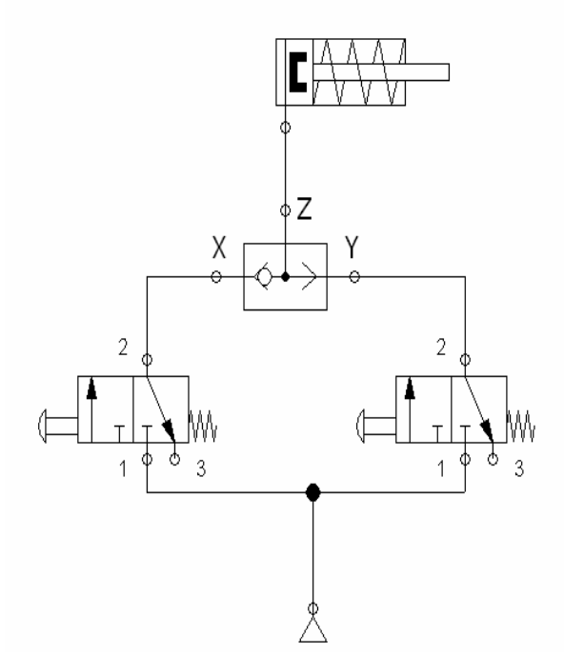
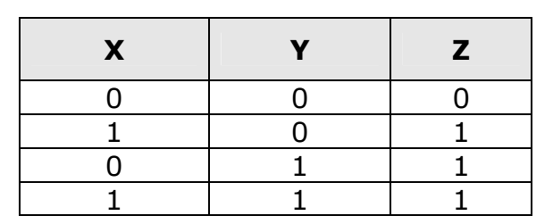
Application of single logic component
Table 1 . Truth table for OR function
1: compressed air is available
0: compressed air is not available
OR function gives output compressed air signal if any input has compressed air signal
Figure 4. Pneumatic circuit with one shuttle valve

Slide 9
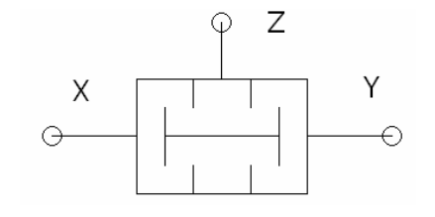
Application of single logic component
This valve is very similar to the shuttle valve in shape and construction, but the function and the principle of operation is different. It is used for the logic AND connections. The picture and the symbol of the valve is shown in figure 6
Figure 6

Slide 10
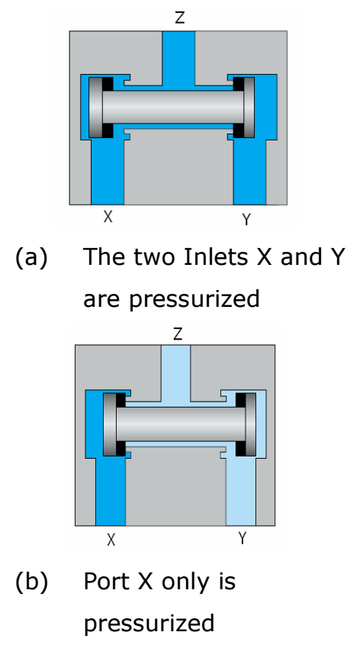
Application of single logic component
In pneumatic logic, a two pressure-valve works as an AND gate If a compressed air signal is applied to input X and input Y at the same time, this will produce a signal at output Z as shown in figure 7.A However, if there is no signal, there is also no output signal.
If only one input signal is applied, there will be no output signal as shown in figure 7.b In case of time differences between the input signals, the signal arriving last reaches the output.
In case of pressure differences between the input signals, the signal with the lower pressure reaches the output.
Figure 7

Slide 11
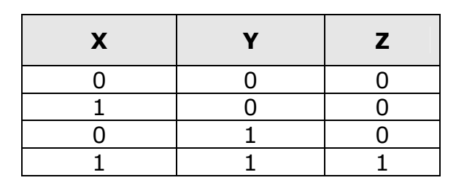
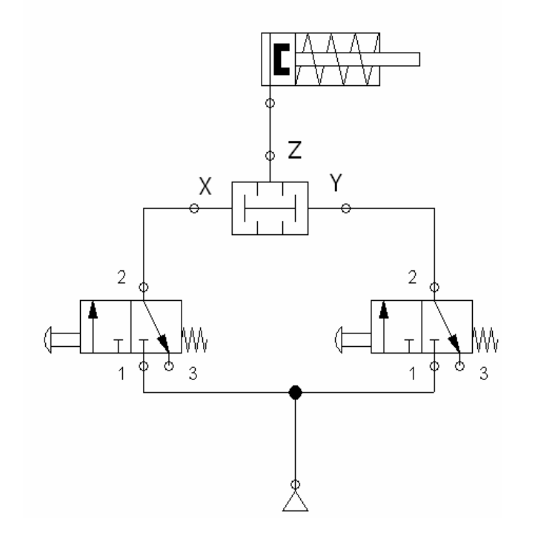
Application of single logic component
Table 2 . Truth table for AND function
1: compressed air is available
0: compressed air is not available
AND function gives output compressed air signal if all inputs have compressed air signals applied at the same time.
Figure 8. Pneumatic circuit with one shuttle valve

Slide 12
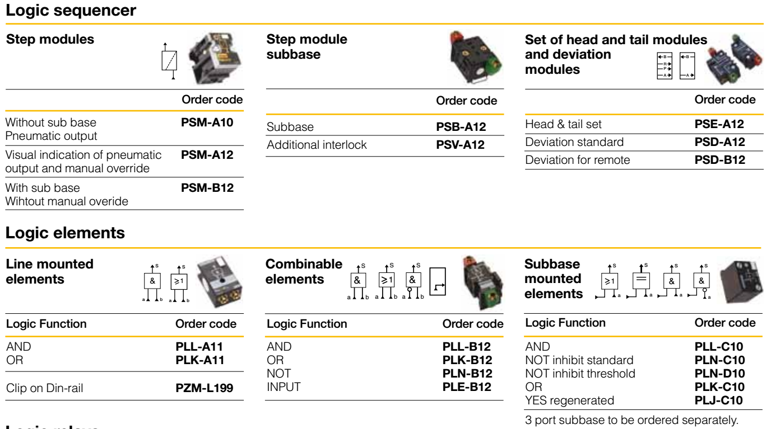
Application of single logic component
Figure 5. Sample of other commercial single logic components

Slide 13
Cause and effect concept
Cause & Effect (C&E) analysis for process plants is one of the tasks associated with Process Control Engineering
Given a P&ID, the Instrument Checker is a tool that identifies the instrument loops and their connections with the process items. The output of this tool is used as input to the rule-based system

Slide 14
Application of complex logic component
Figure 6. Sample of P&ID Diagram
Figure 7. Sample of Cause and Effect Diagram

Slide 15
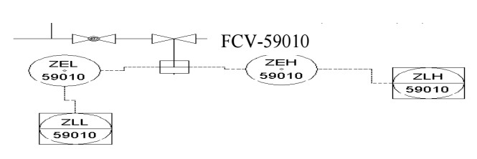
Application of complex logic component
Example
Consider the P&ID shown in figure 1, which is a very small part taken from a much larger plant. The following instruments are identified:
• Two high level alarms – “ZEH-59010” and “ZLH-59010”;
• Two low level alarms – “ZEL-59010” and “ZLL-59010”;
• one control valve – “FCV-59010”.
Figure 8. Sample of Cause and Effect Diagram

Slide 16
Application of complex logic component
Figure 8 shows that process component has four instrument devices attached to it .If any of the two high level alarms goes off then the input control valve FCV-59010 will be closed. If the two low level alarms goes off then the valve will be opened.
Figure 8. Sample of Cause and Effect Diagram

Slide 17
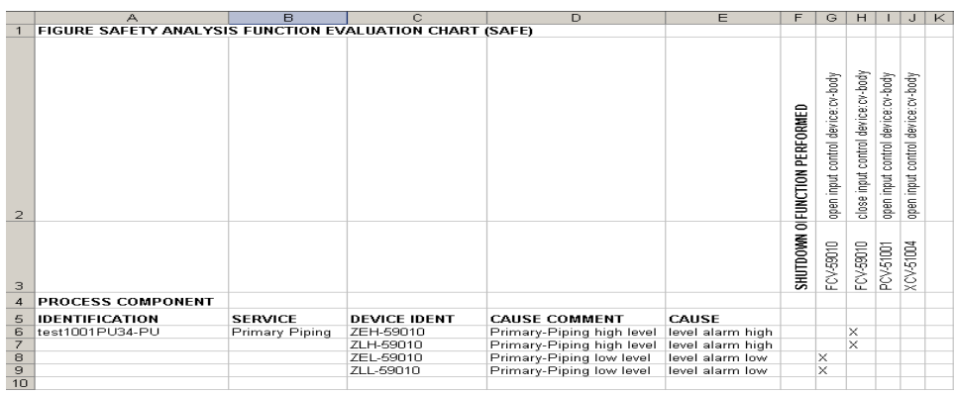
Application of complex logic component
Figure 9. Cause and Effect Diagram

Slide 18
THANK YOU

