Slide 1
Troubleshooting in Hydraulic circuits
Presented By: sameh elshafey
Submitted to : Dr. Kamal Abd Elaziz
Dr. Rola Afify

Slide 2
Table of content:
Introduction.
Take in consideration.
Common causes of hydraulic failure.
General rules for hydraulic maintenance engineers.
Ten steps trouble shooting process.
Before identifying the problem.
Questions to identify the problem.
Troubleshooting check list.
Troubleshooting guides and maintenance hints.
How to prevent hydraulic system failure.
Hydraulic system maintenance.

Slide 3
Introduction
In 1650, french scientist, mathematician and philosopher blaise pascal discovered the fundamental law of physics that forms the basis of all hydraulic systems. Pascal’s law states, “pressure applied to a confined fluid is transmitted undiminished throughout the confining vessel or system.”
In practical terms, if we apply this law to a hydraulic cylinder or motor, any oil pressure applied to the pistons will be transmitted equally in all directions within the fluid filled cylinder or motor.

Slide 4
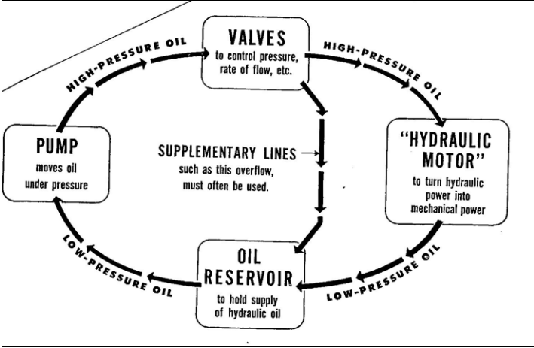
Introduction
Hydraulic systems may be very complex, but every system, no matter how basic, must contain:
Reservoir.
Pump
Various valves to control oil flow, direction and pressure
hydraulic cylinder or motor to move the load applied by oil under pressure.

Slide 5
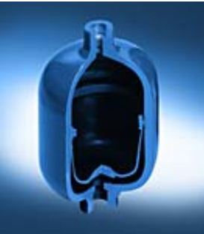
Introduction
Mentally prepare:
Use safety equipment.
Lockout and tagout.
Work with a partner.
Be afraid of hydraulic accumulators.
Have complete documentation.

Slide 6
Take in consideration:
System filtration and cleanliness.
It is claimed that 80% of all breakdowns in hydraulic systems can be directly or indirectly related to fluid contamination.
Using adequate filtration as discussed earlier is a must to reduce system breakdown frequency
The following points should be investigated:
Ensure that the filter fitted to the system are of the recommended rating.
Check that the thank is properly sealed and all gaskets are in good condition.
Check the breather conditions and cleanliness.
When filling the oil tank, use a filter pack to transfer oil- not an old water can.

Slide 7
Take in consideration:
Condition monitoring
A. Hydraulic elements
Condition of pumps, hydraulic motors, and control valves with external drains can be judged by measuring the leakage flow in the drain lines.
It is essential that to measure and record the reference leakage when the element is new
There is no need a flow meter device to measure the leakage. It can be done by using a jar and stopwatch.

Slide 8
Take in consideration:
Condition monitoring
B. Fluid Condition
Contamination monitoring of the hydraulic fluid can be useful on evaluating the performance of the system.
Sample of fluid is drained and inspected regularly to judge the system cleanliness.
Typically, a 250 ml of oil from a low pressure line (less than 14 bar) is preferred to be a reference.
Analyzing the sample can explain the elements wear and filtration effectiveness.

Slide 9
Take in consideration:
Condition monitoring
C. Records and Documenting
It is necessary to maintain an up-to-date information on all system. Necessary data and documents should comprise the following:
A complete circuit diagram and parts list giving details of all pressure settings, operating speeds, and test-points pressure readings. This must be updated every time any modification is carried out.
A spares stock list giving details of all spares carried out.
A record of any breakdowns giving the symptom, cause and repair of the fault, together with the date and length of time the system was down.

Slide 10
Common causes of hydraulic failure:
Air and water contamination.
Air and water contamination are the leading causes of hydraulic failure, accounting for 80 to 90% of hydraulic failures. Faulty pumps, system breaches or temperature issues often cause both types of contamination.
Temperature problems.
Hydraulic systems that run too hot or too cold can cause severe problems over time
Fluid levels and quality.
Fluid levels and quality can affect hydraulic system performance. Low fluid levels and inappropriate filtration can result in air contamination, while fluid contamination can cause temperature problems. Leaks can further exacerbate both issues.
Human error.
Human error is the base cause of many hydraulic system problems. Some of the most common errors that may result in your hydraulic pump not building pressure.

Slide 11
General rules for hydraulic maintenance engineers:
Before working on a machine check the effect on interlocked parts or machines. Chock up all cylinders and parts which may fall under gravity.
Isolate electrical supply and lock control cabinet.
Isolate pump and ensure it cannot be started accidentally.
Bleed fluid to relieve any pressure in system by cracking fittings -cover with cloth to prevent oil spray.
Particular care must be taken in the case of accumulator circuits.
Plug all pipe ends and ports of components to keep out contaminants.
Ensure that components stripped are marked to facilitate correct assembly.
Wash components in the correct fluid. lf in doubt use clean hydraulic fluid as used on the machine.
Use torque wrenches for tightening components. Do not over tighten.
Use extreme care when startingmachine for first time after overhaul.

Slide 12
Ten steps trouble shooting process:
1. Define the problem

Slide 13
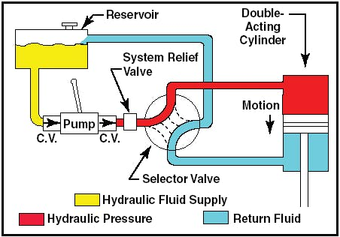
Before identifying the problem:
Studying the hydraulic schematic, which means not just a cursory glance but rather reading and tracing it, can often help a good technician identify the problem without having to pull any parts. It also saves time.

Slide 14
Questions to identify the problem:
Is the problem a leak? If so, is hydraulic fluid or lubricant leaking? Where is the leak occurring?
Was there a significant pressure change noticed in the system? Was it a pressure loss or pressure spike? Approximately where in the system did it occur?
Is something overheating?
Is a component, such as a pump or motor, making an abnormal sound or vibrating?
Did the system experience a loss of speed? Approximately where did it occur?
How often does the problem happen? Was it a one-time occurrence, or does it happen intermittently?

Slide 15
Troubleshooting check list:
Check the motor: Ensure the motor has the correct wiring and can turn on and off.
Check the pump: Take the pump assembly apart and assess all parts to ensure that they are functional and installed correctly. The most common problem areas include the pump shaft, coupling and filter.
Check the fluids: Check the level, color and viscosity of the hydraulic oil to ensure it meets specifications and has not become contaminated. Low hydraulic fluid symptoms include pressure or power loss. When in doubt, drain and replace the fluids.
Check the seals: Look for evidence of any fluid leakage around your hydraulic system's seals, especially the shaft seal. Leakage can indicate worn-out or blown seals that can cause malfunctions with pumps, motors and control valves.
Check the filters: Ensure filters are clear of plugs and blockages. Common clogged hydraulic filter symptoms include sluggish operation and noisy operation.
Check valves and lines: Observe all lines for potential leaks, and tighten every connection point. Also, check the relief valve for any signs of damage.
Run the system: When you have completed all these essential checks, turn on the system and monitor it for pressure and temperature fluctuations, as well as abnormal sounds. If all seems well, check your pressure sensor for potential failure.

Slide 16
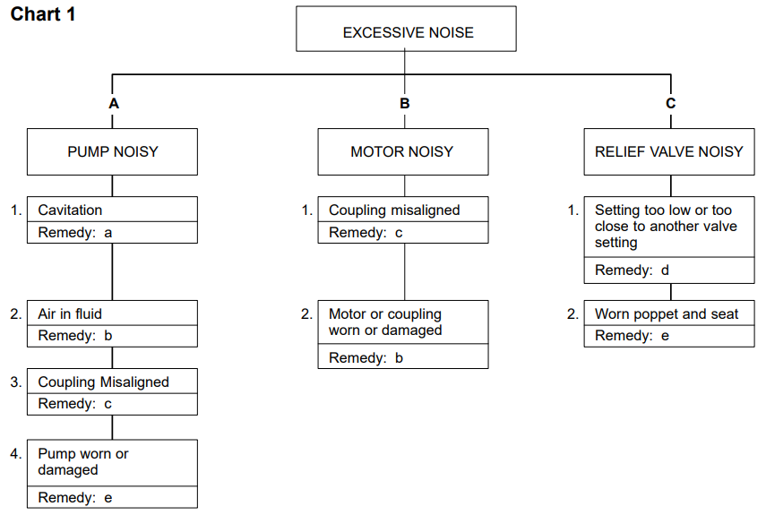
Troubleshooting guides and maintenance hints:
Any or all of the following: replace dirty filters; wash strainers in solvent compatible with system fluid; clean clogged inlet line; clean or replace reservoir breather vent; change system fluid; change to proper pump drive motor speed; overhaul or replace supercharge pump; fluid may be too cold.
Any or all of the following: tighten leaking connections; fill reservoir to proper level bleed air from system; replace pump shaft seal.
Align unit and check condition of seals, bearings and coupling.
Install pressure gauge and adjust to correct pressure.
Overhaul or replace

Slide 17
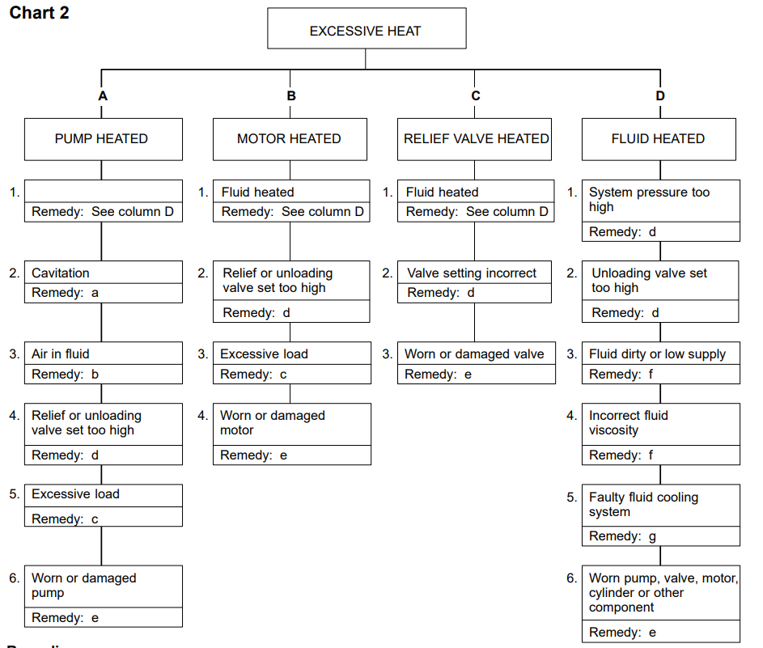
Troubleshooting guides and maintenance hints:
Any or all of the following: replace dirty filters; clean clogged inlet line; clean or replace reservoir breather vent; change system fluid; change to proper pump drive motor speed; overhaul or replace supercharge pump.
Any or all of the following: tighten leaking connections; fill reservoir to proper level; bleed air from system; replace pump shaft seal.
Align unit and check condition of seals and bearings; locate and correct mechanical binding; check for work load in excess of circuit design.
Install pressure gauge and adjust to correct pressure .
Overhaul or replace.
Change filters and also system fluid if improper viscosity; fill reservoir to proper level.
Clean cooler and/or cooler strainer; replace cooler control valve; repair or replace cooler

Slide 18
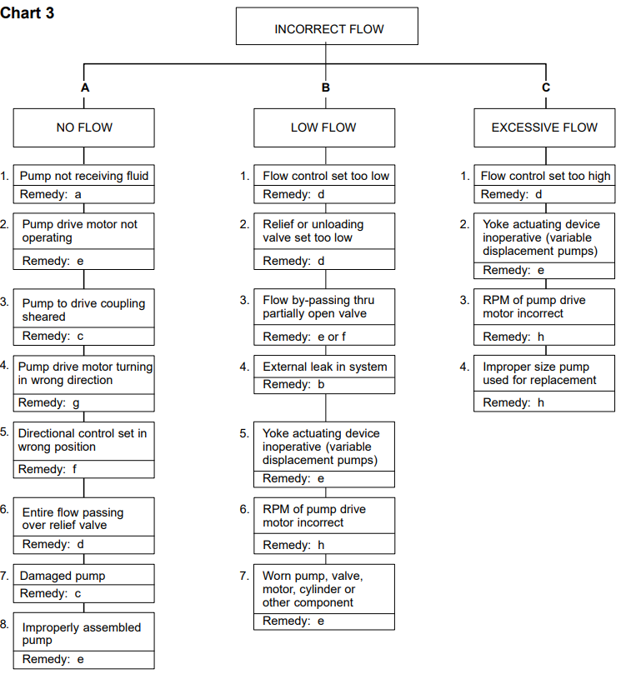
Troubleshooting guides and maintenance hints:
Any or all of the following: replace dirty filters; clean clogged inlet line; clean or replace reservoir breather vent; fill reservoir to proper level; overhaul or replace supercharge pump.
Tighten leaking connections.
Check for damaged pump or pump drive; replace and align coupling.
Adjust.
Overhaul or replace.
Check position of manually operated controls; check electrical circuit on solenoid operated controls; repair or replace pilot pressure pump.
Reverse rotation.
Replace with correct unit.

Slide 19
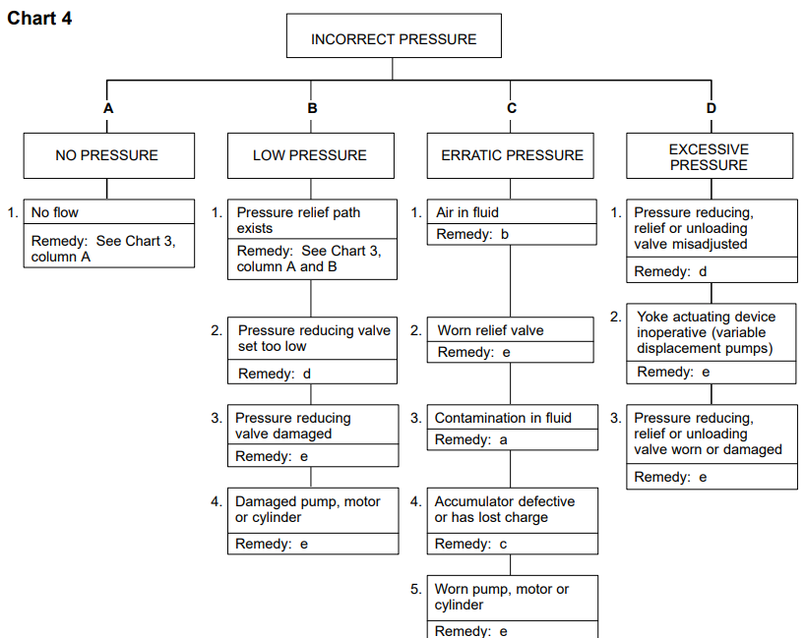
Troubleshooting guides and maintenance hints:
Replace dirty filters and system fluid.
Tighten leaking connections (fill reservoir to proper level and bleed air from system).

Slide 20
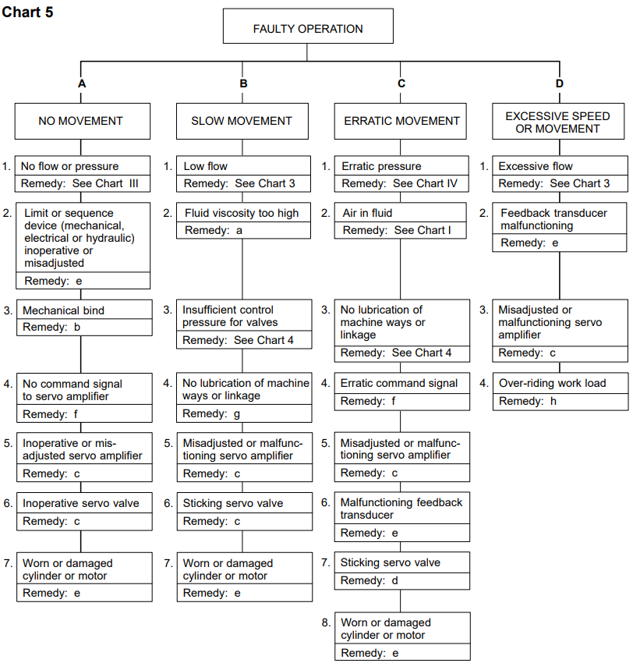
Troubleshooting guides and maintenance hints:
Fluid may be too cold or should be changed to clean fluid of correct viscosity.
Locate bind and repair.
Adjust, repair or replace.
Clean and adjust or replace; check condition of system fluid and filters.
Overhaul or replace.
Repair command console or interconnecting wires.
Lubricate.
Adjust, repair or replace counterbalance valve.

Slide 21
How to Prevent Hydraulic System Failure:
Hydraulic system issues are inevitable at some point. However, simple steps can help you avoid these issues and increase the longevity of your hydraulic system. On top of effective troubleshooting, you can prevent hydraulic system failure by taking the following steps:
Follow specifications: We can trace the most common hydraulic system issues back to fundamental system problems like incompatible or improperly installed parts. For this reason, it's essential to always double-check specifications to ensure your purchased parts can work together seamlessly.
Consult with professionals: When purchasing new equipment, consult with industry peers and professionals to discover what they recommend. While manufacturers can tell you how a product should work, industry professionals can provide concrete examples of how well the equipment works for their industry.
Perform maintenance: It is essential to focus your operations on equipment longevity. Review your daily, monthly and annual maintenance procedures to ensure you are covering every aspect of your system according to best maintenance practices and catch symptoms early on.

Slide 22
Hydraulic System Maintenance:
Regularly review hydraulic system maintenance, always following manufacturer recommendations and industry best practices. Also, consider the storage condition, external influences, working pressure and usage frequency of your system to tailor your maintenance schedule and procedures.
Generally speaking, you should perform maintenance at three levels.
Daily tasks: Take care of a few simple daily checks to avoid issues. For example, personnel should check the oil levels, hoses and connections and listen to the pump for abnormal sounds.
Routine tasks: Plan and execute a weekly and monthly maintenance routine, checking for the most common failure sources given your system's working conditions. These should include components, filters and the condition of the oil.
Complete system checks: Depending on the conditions of your system, you and your team should perform complete systems checks monthly, quarterly or annually. Tasks should include running a comprehensive report on the system, cleaning devices, draining the system and replacing damaged parts.

Slide 23
Thank YOU

