Slide 1
Servo valve
NAME: Ahmed Reda Khalil
REG.NUMBER: 24224432

Slide 2
OUT LINES
1- What is the servo valve?
2- Main component of servo valve
3- Classification of Servo Valves
4- Application of servo valve
5- Advantages and dis advantages

Slide 3
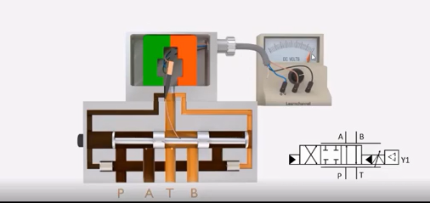
1- What is the servo valve?
Definition: A precision electro-hydraulic directional control valve used for high-performance motion control.
Core Function: It acts as an interface, converting low-power electrical signals (input) into high-power hydraulic flow or pressure (output)

Slide 4
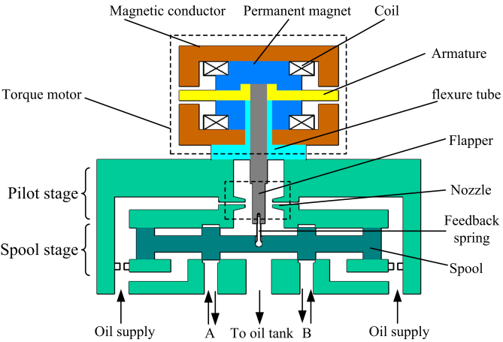
2- Main component of servo valve
Stage 1: The Electrical Stage (Input):
Permanent Magnets: Create a constant magnetic field for the armature to interact with.
Electromagnetic Coils: Convert the electrical command (mA) into a magnetic force.
Armature: A metal beam that pivots to initiate mechanical movement.
Flexure Tube: Supports the armature and acts as a seal to keep oil away from the electronics

Slide 5

2- Main component of servo valve
Stage 2: The Pilot Stage (Amplification)
Flapper: A thin lever that moves between nozzles to control oil flow.
Nozzles (Dual): Spray jets of oil; their restriction creates the pressure difference needed to move the spool.
Internal Filter: A fine mesh that prevents tiny particles from clogging the nozzles.

Slide 6
2- Main component of servo valve
Stage 3: The Power Stage (Output)
Main Spool: The sliding core that opens or blocks the main oil paths to the machine.
Bushing (Sleeve): The high-precision housing where the spool slides with zero friction.
Feedback Wire: A spring that pulls the flapper back to center to ensure the spool stops at the exact position.

Slide 7
Classification of Servo Valves
By Number of Stages
Single-Stage: Direct drive (Torque motor moves the spool directly).
Two-Stage: Pilot-operated (Pilot stage controls the main power spool).
Three-Stage: High-flow capacity (Used for massive industrial applications).

Slide 8
Classification of Servo Valves
2. By Pilot Stage Design (Mechanism)
Nozzle-Flapper: High precision and rapid response speed
Jet Pipe: Robust design with high contamination tolerance.
Deflector Jet: High efficiency and reliable performance.

Slide 9
Classification of Servo Valves
By Control Function
Flow Control: Regulates speed and direction of actuators.
Pressure Control: Manages output pressure proportional to input.

Slide 10
Application of servo valve
Aerospace: Flight control surfaces (flaps, rudders) and landing gear.
Industrial Machinery: High-speed plastic injection molding and die casting.
Heavy Equipment: Steel and rolling mills for precise thickness control.
Testing & Simulation: Flight simulators and automotive material testing rigs.
Power Generation: Controlling steam and gas turbine governors

Slide 11
5- Advantages and dis advantages
Advantages
dis advantages
Extreme precision (accuracy within 0.025 mm).
Very high frequency response (>100 Hz).
High power-to-weight ratio
High Cost: Significant investment compared to standard valves.
Complex Maintenance: Requires specialized labs for repa

Slide 12
THANKS

