Slide 1

COMPARISON OF HYDRAULIC CONTROL VALUES:
TRADITIONAL, PROPORTIONAL, AND SERVO VALUES
Understanding Their Features, Applications, and Best Use Cases
BY/ Asser Mohamed

Slide 2

Introduction
Hydraulic control valves are fundamental components in modern hydraulic system, playing a critical role in controlling the flow rate and maintaining optimal pressure to ensure smooth and efficient system performance. By precisely regulating the movement of hydraulic fluid, these value help achieve the desired output in a wide range of applications, from industrial machinery to aerospace system. This presentation explores the distinctions, helping select the right value for your system’s needs.
KEY CATEGORIES OF HYDRAULIC CONTROL VALUES:
Traditional Valves: Simple on/off operation for basic flow control.
Proportional Valves: Offers variable flow control for moderate precision.
Servo Valves: Enable high-precision adjustment with feedback loops.

Slide 3
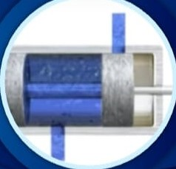
TRADITIONAL CONTROL VALUES
Features:
Operates in binary states: fully open, closed, or redirecting flow.
Simple design, easy to install and maintain.
Dose not require sophisticated electronics.
Advantages:
Cost-effective, robust, low maintenance.
Disadvantages:
Limited precision, requires additional circuits for complex operation
Applications:
Irrigation system, basic industrial machinery, simple flow control.

Slide 4
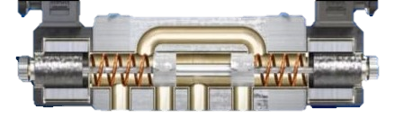
PROPORTIONAL CONTROL VALUES
Features:
Enable variable control overflow, speed, and direction via electrical signals.
Operates using DC current: voltage levels determine value movement.
Advantages:
Enhanced precision, versatile functionality, improved efficiency.
Disadvantages:
Sensitive to environmental changes, higher energy consumption.
Applications:
Complex hydraulic circuits needing variable flow and speed adjustment

Slide 5
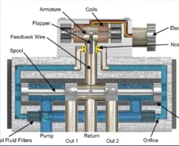
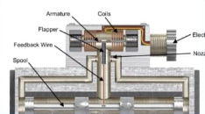
SERVO VALUES
Features:
Delivers precise flow and pressure control with closed-loop feedback.
High-frequency response, capable of fine and repeatable operations.
Advantages:
Unmatched precision, high responsiveness, and versatility in complex systems.
Disadvantages:
High cost, requires premium-quality fluids, demands skilled maintenance.
Applications:
Aerospace system, robotics, high-precision industrial machinery

Slide 6
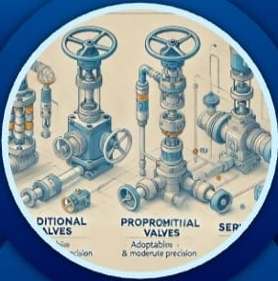
BEST TYPE OF VALUS
Criteria for Selection:
Complexity: Choose simplicity or precision based on system needs.
Budget: Consider initial and maintenance costs.
Application: Align value functionality with operational demands.
Recommendations:
Traditional Values: Best for simple, cost-efficient systems.
Proportional Values: Suitable for adaptable, moderate-precision needs.
Servo Values: Ideal for advanced, high-precision requirements.

Slide 7
CONCLUSION
Summary:
Traditional values: Cost-effective for basic system
Proportional values: Balances cost and adaptability
Servo values: High-precision solutions for demanding applications.
Call to Action:
Evaluate Your system requirements, constraints, and operational goals to select the most suitable hydraulic control value

